Slide 1
Exploratory Data Analysis
Data Science Persistency of a Drug Project
DS HealthCare Group Members:
Yuchi Chen
Bolutife Akinlawon
Alexis Collier
Han-Fu Lin
Runtian Wang

Slide 2
Agenda
Data Analysis Approach
Problem Understanding
Business Understanding
Data Preparation
Exploratory Data Analysis
EDA Summary
Model Building
Model Selection
Final Recommendation
Conclusion

Slide 3
Data Analysis Approach
One of the challenges for all Pharmaceutical companies is understanding the persistency of drugs as per the physician’s prescription.
To solve this problem, ABC pharma company is seeking to automate this process of identification by:
Explore and Understand the data
Prepare and clean the data
Analyze the data and find the features/variables that affect drug persistency
Give recommendations for the classification model that is to be built to automate the process of drug persistency identification

Slide 4
Problem Understanding
ABC Pharma is a pharmaceutical company that aims to automate the identification of the persistence of a drug.
In this data analysis, the various factors of a patient are evaluated to determine if they affect persistency. The data is collected for analysis to determine the durability of the drug.
At the end of this project, we will suggest a model follow for deployment.

Slide 5
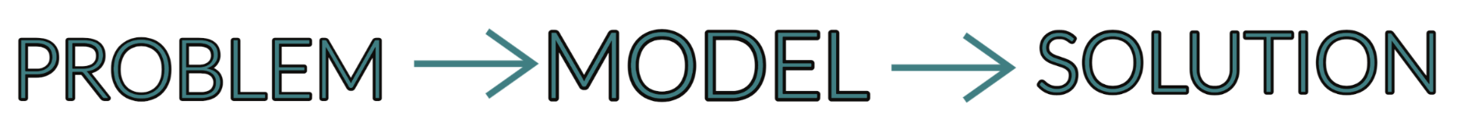
BUSINESS UNDERSTANDING
In summary, the task can be represented as follows:

Slide 6
DATA PREPARATION
Python was utilized for data preparation, as well as pandas library specifically.
Data was cleaned and prepared for analyzation.
Method of Approach:
Look for null or missing values.
Identify values that are improbable.
Create visualizations of the data.

Slide 7
EXPLORATORY DATA ANALYSIS
We analyzed the demographic data characteristics, including gender, race, ethnicity, region, age bracket, and iodine indicator.
The data variables are represented via stacked bars and correlation heatmaps.

Slide 8
EXPLORATORY DATA ANALYSIS
Some demographic observations include the following:
More significant number of female participants.
There are more persistent than non-persistent participants, indicating an imbalanced dataset.
The primary racial demographic of the dataset is caucasian (non-Hispanic).
Most of the participants are 75 and older.
‘Below 55’ age bracket is the least represented age demographic.

Slide 9
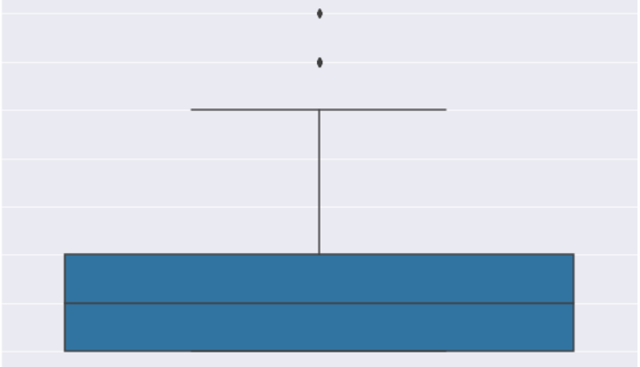
Outlier Test

Slide 10
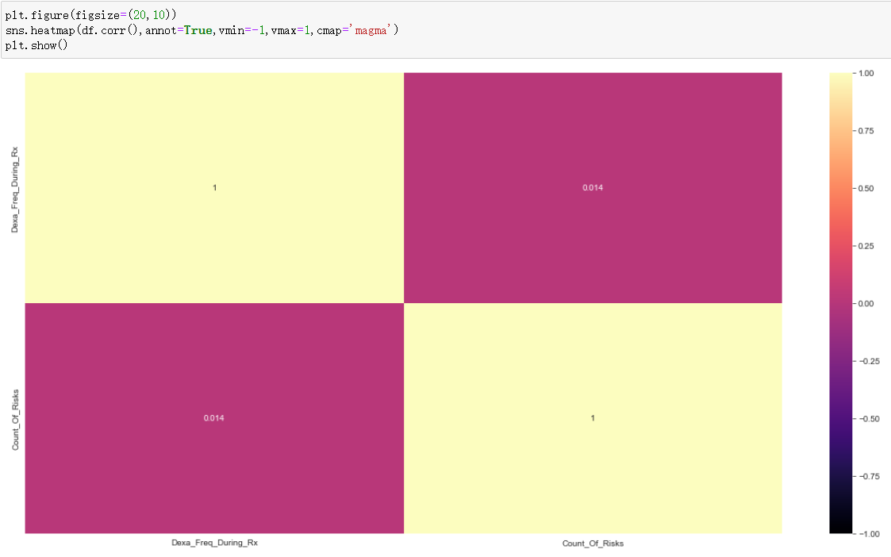
Heatmap

Slide 11
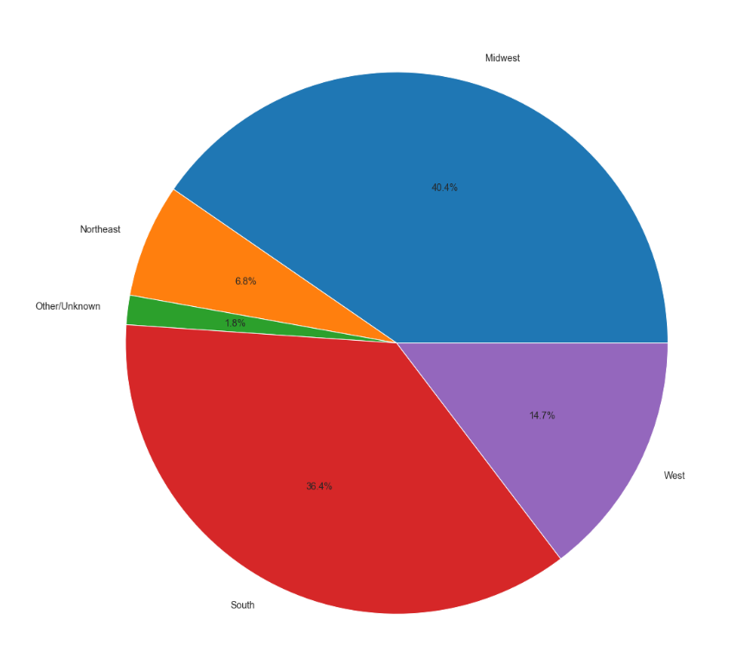
Data Amount by Region

Slide 12
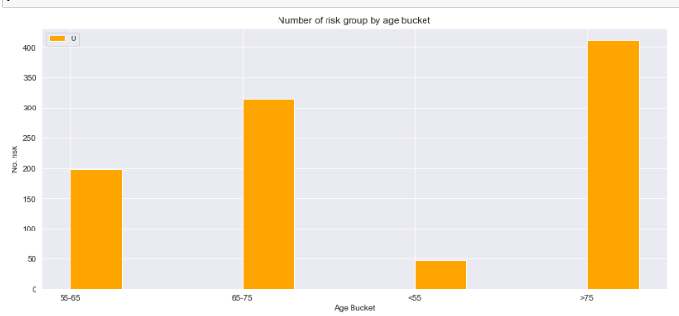
Risk Count by Different Age Group

Slide 13
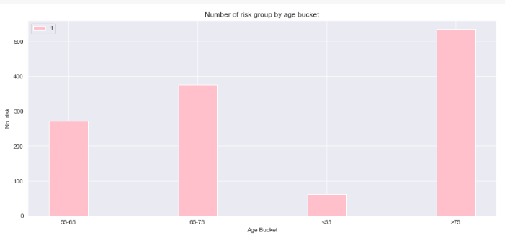
Number of Risk Group by Age Bucket

Slide 14
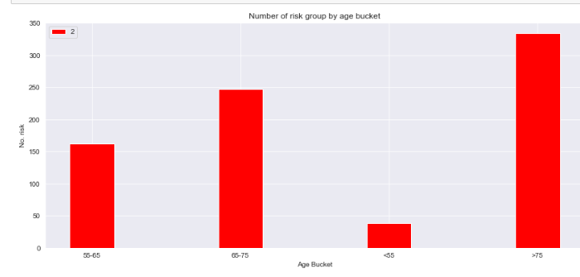
As a result, the count of risk doesn’t show much difference in different age group.

Slide 15
As a result, the count of risk doesn’t show much difference in different age group.

Slide 16
EDA Summary
Out of the many factors that may affect a patient’s persistency to a drug, having risks, being of a certain race, ethnicity, age group, and the specialty of the HCP has the strongest effect on a patient’s persistency towards a drug.
Now that the factors have been identified, we can use a model to create an automated process that predicts whether a drug will be persistent on a patient or not. The random forest classifier model would be the best one to use in this scenario for predicting whether or not a patient would have persistency with a drug.

Slide 17
Model Building
In the model-building stage, various regression techniques were used to classify the Drug Persistency of subjects based on the predictor variables. After preparing the features of the machine learning model to predict data by transforming categorical data into numbers, it is then time for the model-building step.
We used two different regression techniques:
Decision Tree Classifier
Random Forest Classifier

Slide 18
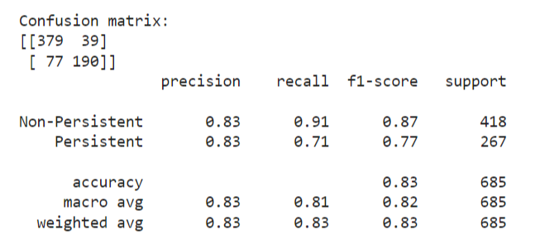
Model Selection
To select the best model, we looked at the performance metrics used, which are: Accuracy, Precision, Recall, F1-Score, Support, and AUC.
The best model is Random Forest Classifier.

Slide 19
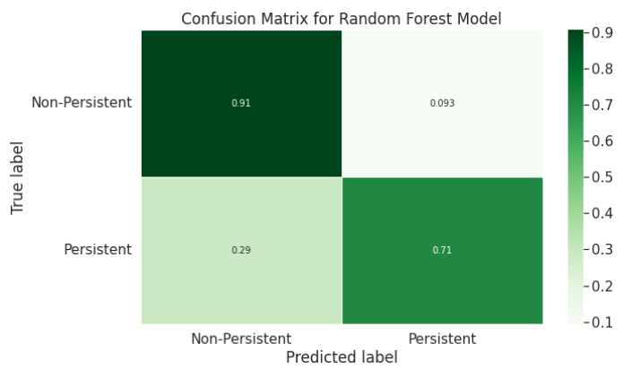
Model Selection

Slide 20
Final Recommendation
Random Forest Classifier is the best fit model for our dataset, with an accuracy score of 0.83.
From various Classification models, Random Forest Classifier was chosen based on the different parameter values:
• It has an accuracy of 83
• This could be the efficient model for the automation of the prediction of persistent or non-persistent drugs

Slide 21
Thank You

